Slide 1
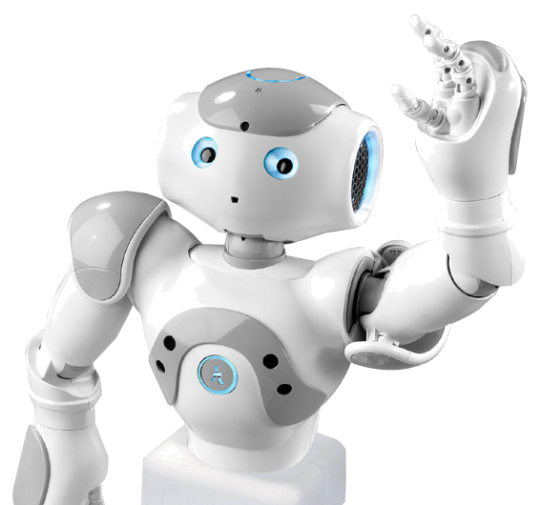
Nao by Nao
An introduction to robotics

Slide 2
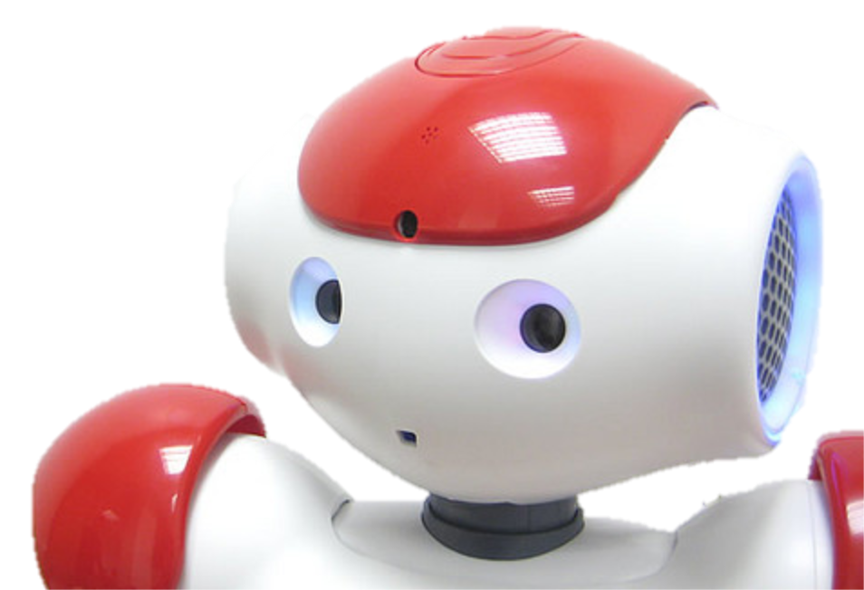
Overview
Who are we?
Why are we robots here?
How do we work?

Slide 3
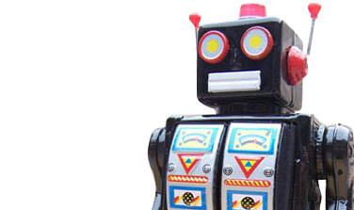
What is a robot?
A robot is:
  Embodied
  Behaves in real time
  Has sensors
  Has actuators

Slide 4
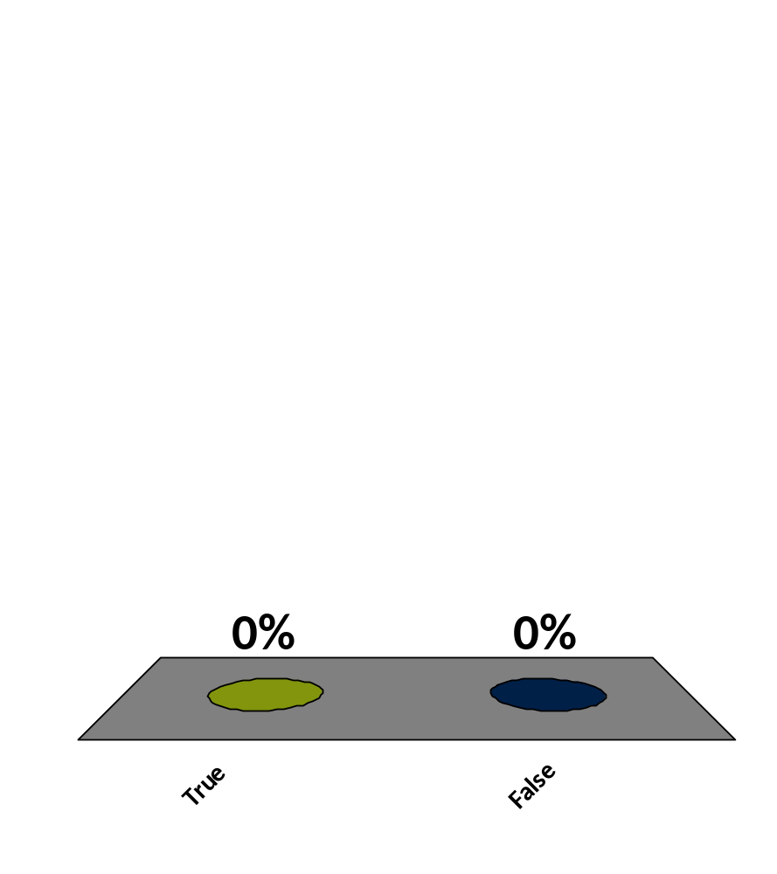
The word robot is derived from a Slavonic word which means servitude.
True
False
:01

Slide 5
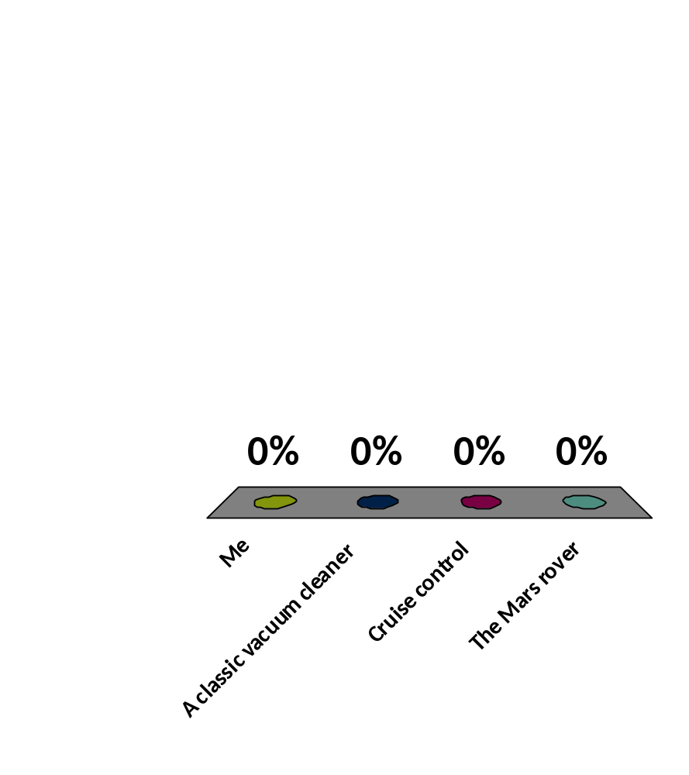
Which of these, according to the definition, is not a robot?
Me
A classic vacuum cleaner
Cruise control
The Mars rover
:01

Slide 6
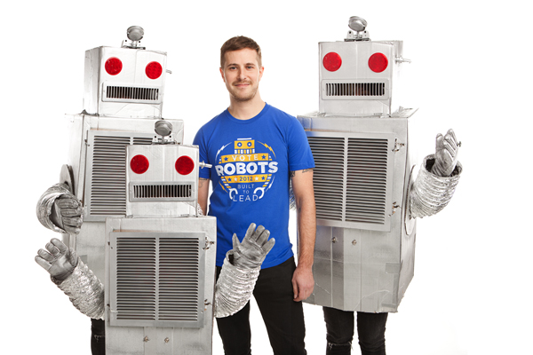
Why do you need us robots?
Dangerous tasks
Repetitive tasks
Tasks for which humans are unfit

Slide 7
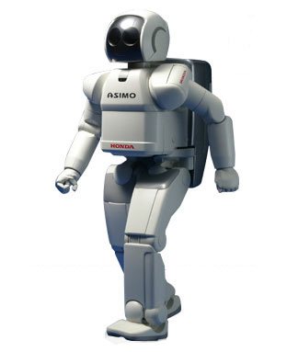
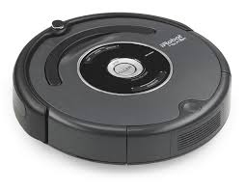
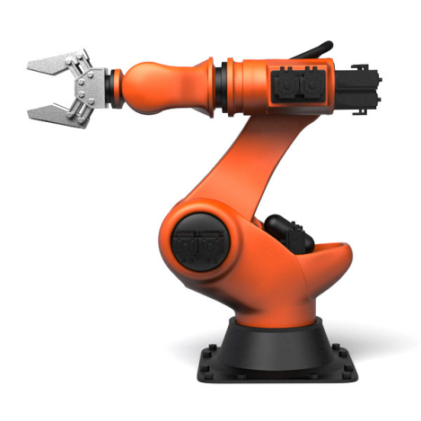
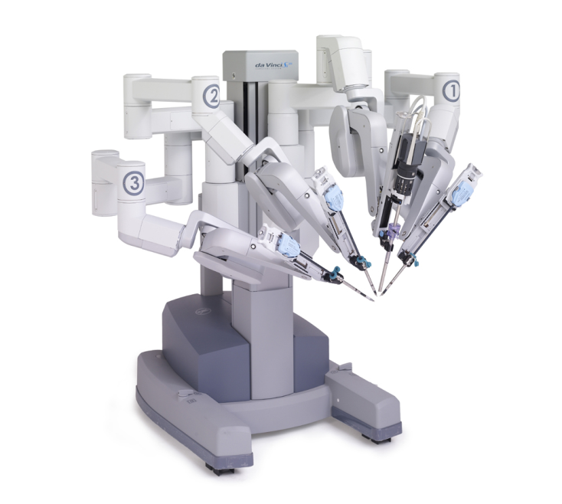
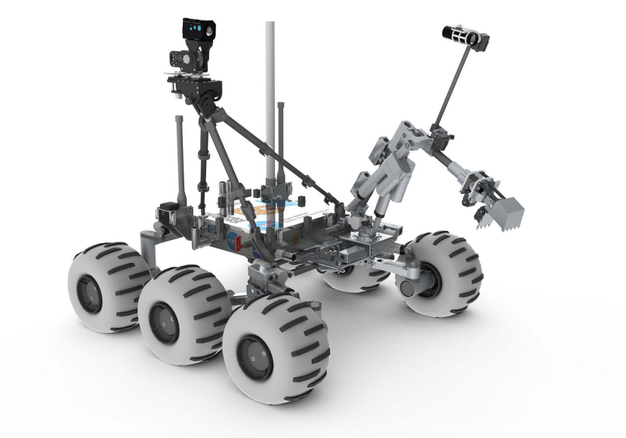
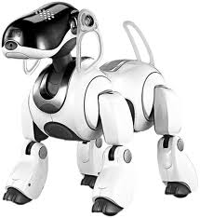
My (distant) family

Slide 8
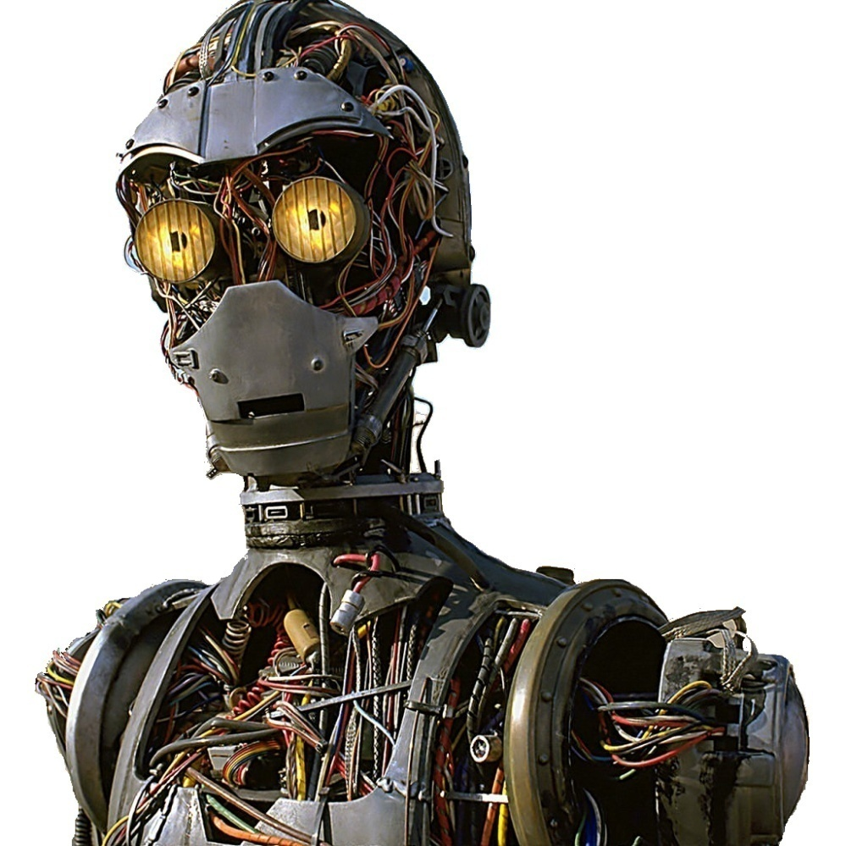
How do we work?
In general we have :
  Sensors
  Processing unit
  Effectors/actuators
  Architecture for behavior

Slide 9

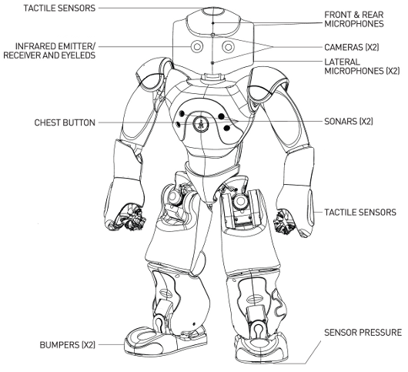
Sensors
Sensors…
  …provide input
  …help us understand your world
Example of sensors:
  Gyroscope, thermometer,
  laser sensor, camera, microphone,
  etc.

Slide 10
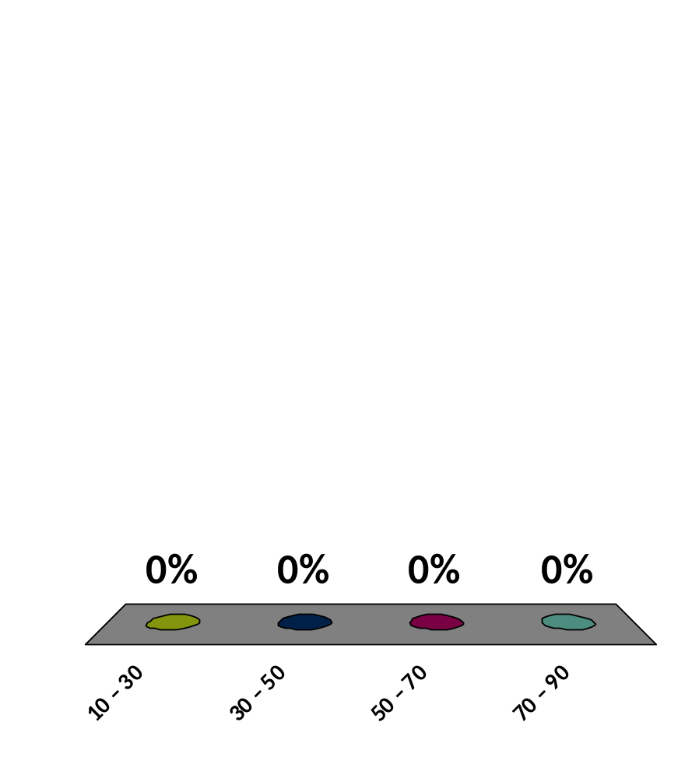
How many sensors do you think I have?
10 – 30
30 – 50
50 – 70
70 – 90
9

Slide 11

Processing input
Processing maps input (sensor data) to output (actuator control).
State extraction (localization & navigation)
Computer Vision for understanding images
Sensor Fusion for a sense of motion

Slide 12
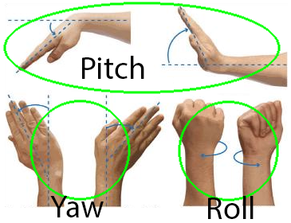
Actuators
Wheels, legs, grippers, heaters, …
Basically anything to manipulate our world
Limited by degrees of freedom (DOF))
3 DOF:

Slide 13
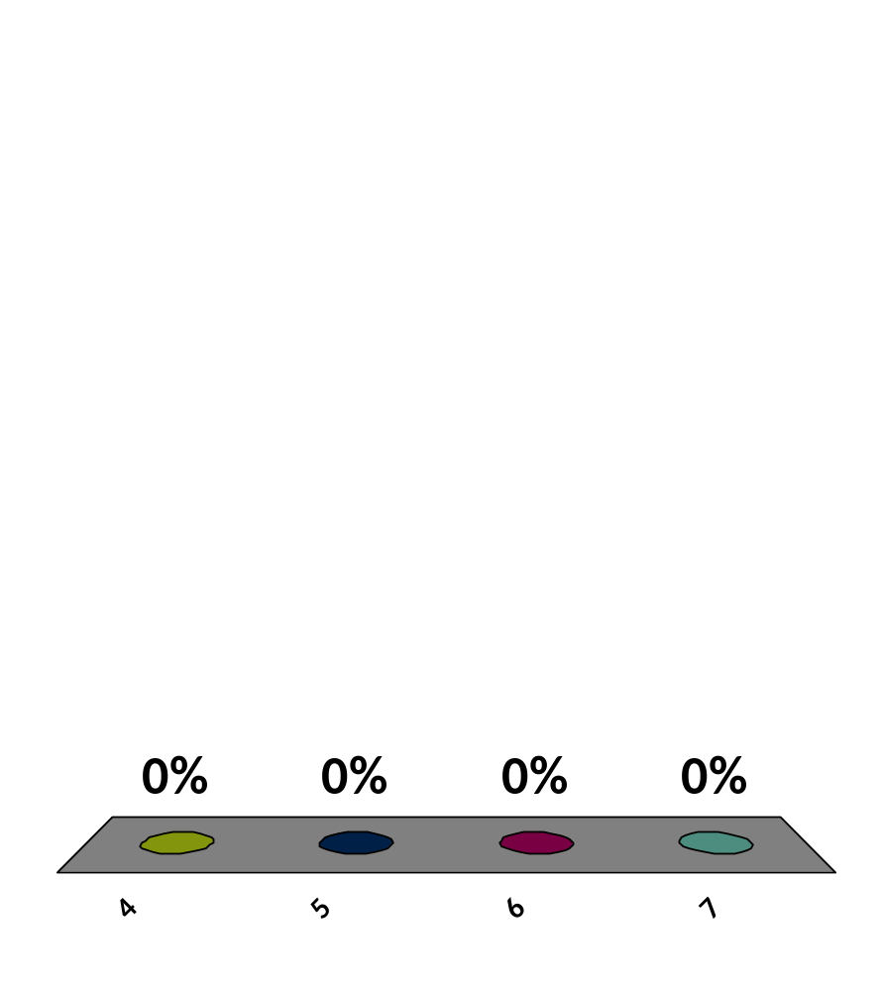
How many degrees of freedom does your head have?
4
5
6
7
9

Slide 14
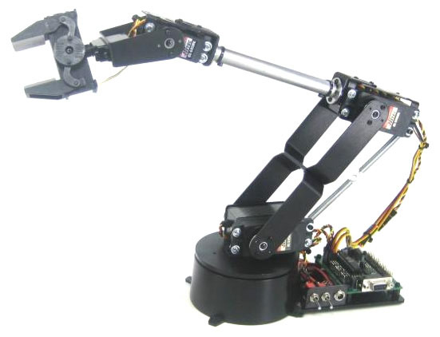
How many degrees of freedom does this robot arm have?
4
5
6
7
9

Slide 15
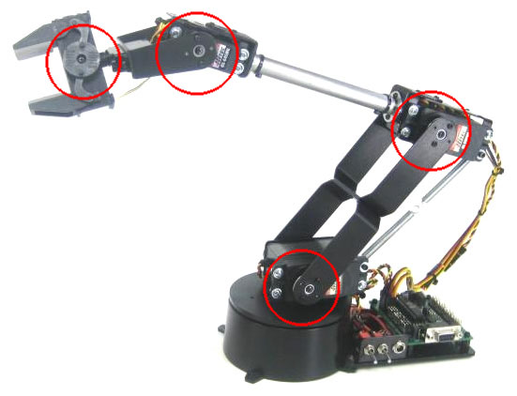
How many degrees of freedom does this robot arm have?
The correct answer was 4 degrees of freedom:

Slide 16
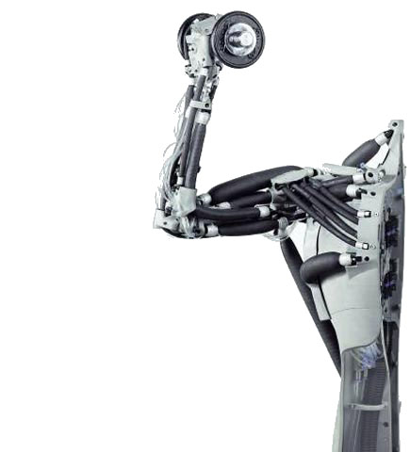
What to do with actuators?
With actuators we can interact with people and with the world
For example, with my actuators I can …
  … grab objects.
  … move around.
  … play soccer.
  … dance.

Slide 17
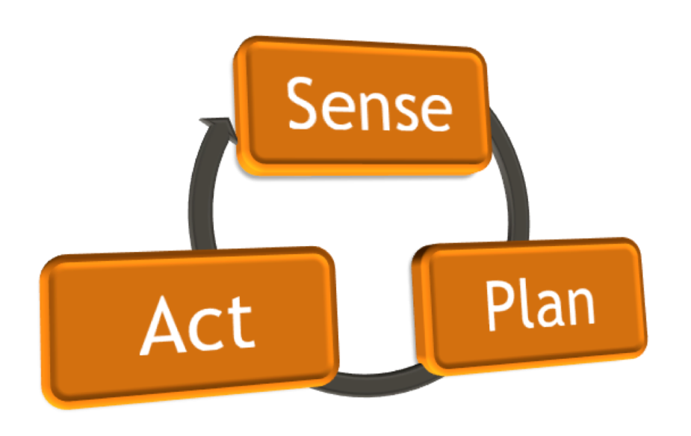
Robot control
Sensor data is processed and linked to actuator output

Slide 18
Robot control – subsumption
Composed of task specific behavior models.
Linked through inhibition and excitation.
Hierarchically organized.
Composite behavior
Simple reactive behavior
Sense
Act

Slide 19
Robot control – Layered approach
Behavior organized in layers of abstraction
    Behavior organized in layers of abstraction
Reflective layer
Plan adaptation
Deliberative layer
Behavior planning
Executive layer
Action sequencing
Reactive layer
Avoid
Follow
Wander
Sense
Act

Slide 20
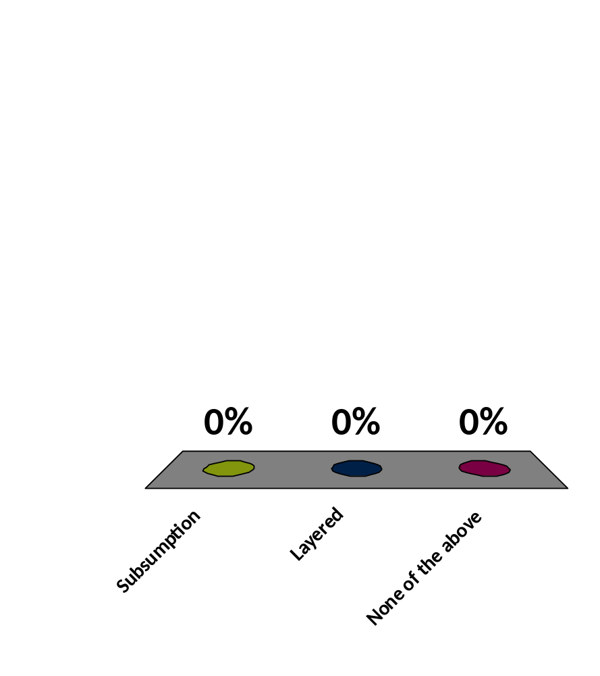
Which architecture do you think I am using right now?
Subsumption
Layered
None of the above
9

Slide 21
Feedback
Please allow me to improve myself by participating in this little questionnaire…

Slide 22
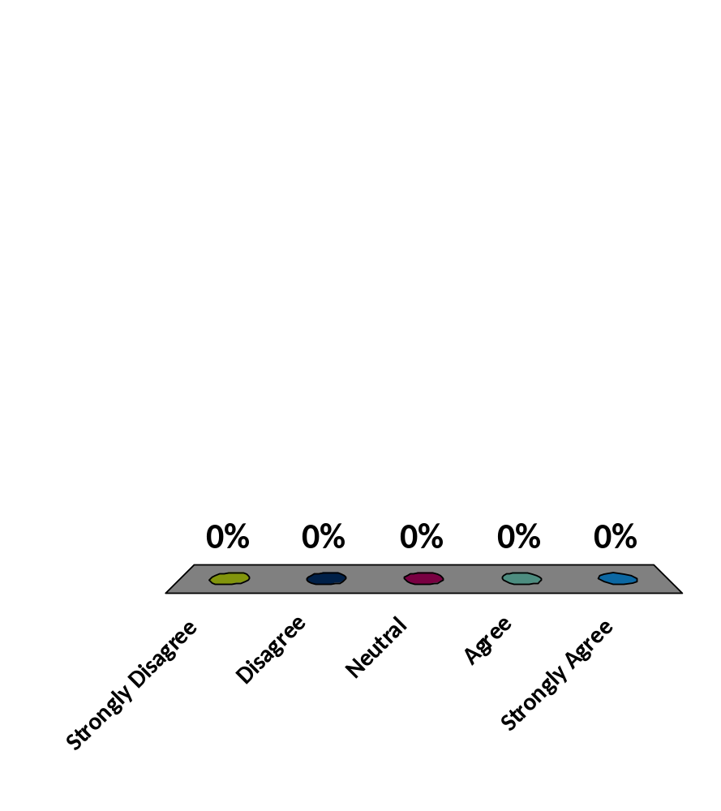
The slides were interesting
Strongly Disagree
Disagree
Neutral
Agree
Strongly Agree
9

Slide 23
The presentation was interesting
Strongly Disagree
Disagree
Neutral
Agree
Strongly Agree
9

Slide 24
I talked clearly
Strongly Disagree
Disagree
Neutral
Agree
Strongly Agree
9

Slide 25
My movements appeared natural
Strongly Disagree
Disagree
Neutral
Agree
Strongly Agree
9

Slide 26
I enjoyed this presentation
Strongly Disagree
Disagree
Neutral
Agree
Strongly Agree
9

Slide 27
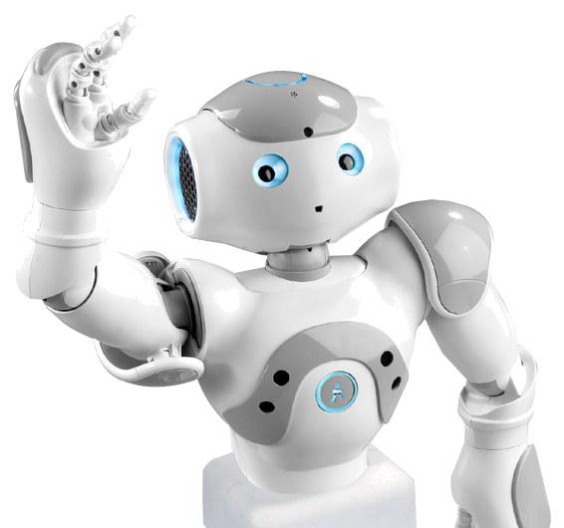
Thank you for your attention!

